Slide 1

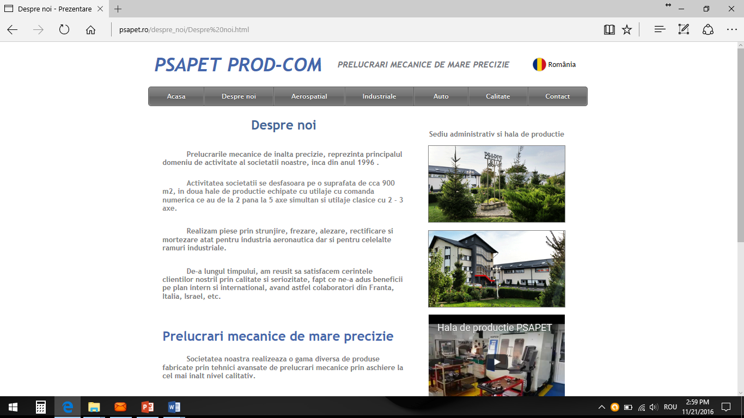
High precision machining

Slide 2

COMPANY OVERVIEW
PSAPET PROD COM SRL is a Romanian manufacturer specialized in high-precision CNC machining for aerospace and industrial applications.
• Established in 1996
• Private family-owned company
• More than 25 years of manufacturing experience
• Production of small and medium series
• Manufacturing of complex precision mechanical components

Slide 3

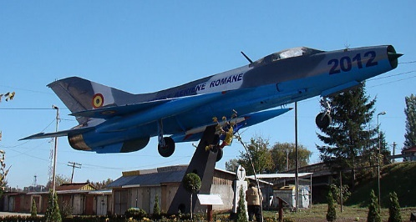
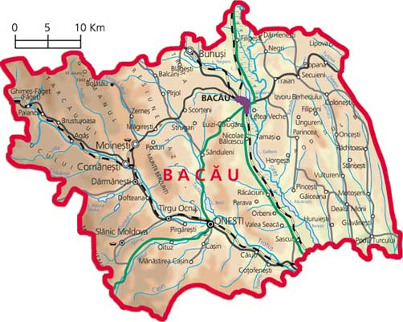
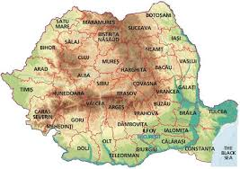
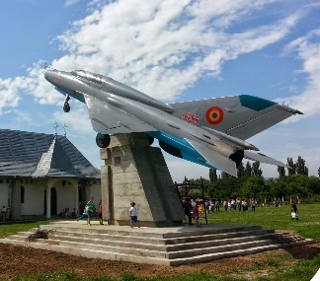
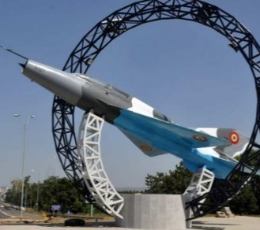
High precision machining
- operators/qualified staff in the AERO field
- high school and college of
AERO profile
- suppliers and utilities
AEROSTAR
MOTORSTAR
ELMET INTERNATIONAL
THE MOST IMPORTANT ROMANIAN AERONAUTICAL CENTER
3/15 Calea Romanului 43, Bacău, 600384, România, Tel.0234 570 633, E-mail: office@psapet.ro www.psapet.ro

Slide 4

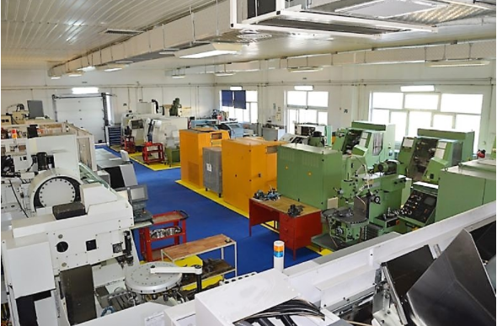
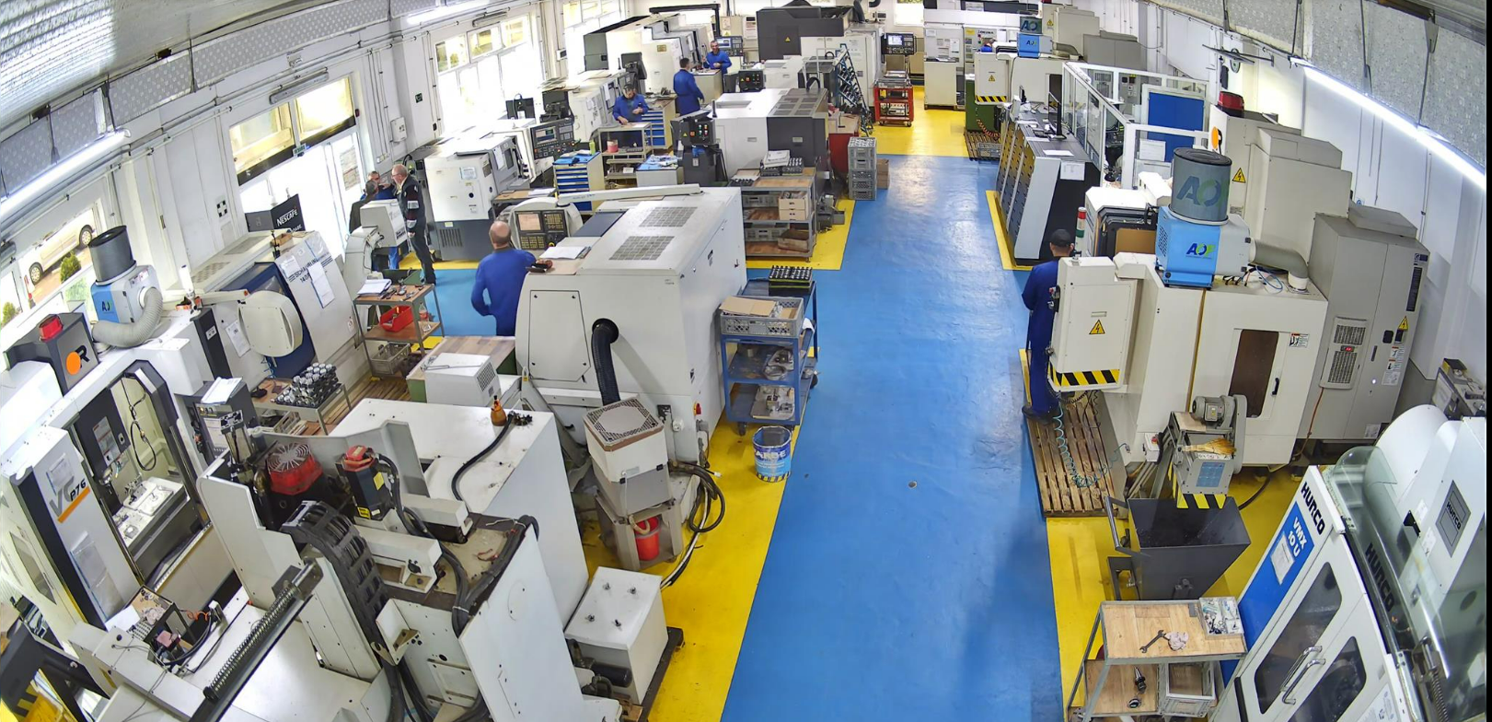
Company Evolution
1996
Company founded with conventional machining equipment.
2000
First investments in CNC machines.
2004 – Present
Continuous modernization of CNC equipment.
Today
Modern CNC machining capabilities and precision manufacturing

Slide 5
CORE COMPETENCIES
PSAPET provides precision machining solutions for complex mechanical components.
• High precision CNC machining
• Complex geometry machining
• 3-axis / 4-axis / 5-axis machining
• Tight tolerance manufacturing
• Production based on customer drawings
MATERIALS MACHINED
PSAPET machines a wide range of materials used in aerospace and industrial applications.
• Aluminum alloys
• Titanium alloys
• Stainless steels
• Alloy steels
• Engineering plastics

Slide 6
MACHINING OPERATIONS
• CNC turning
• CNC milling
• Multi-axis machining
• Drilling and tapping
• Precision finishing operations
CNC EQUIPMENT
Production Equipment
PSAPET operates modern CNC machinery designed for precision manufacturing.
• CNC turning centers
• CNC machining centers – 3 axis
• CNC machining centers – 4 axis
• CNC machining centers – 5 axis

Slide 7
METROLOGY
• Metrology & Inspection Equipment
To ensure dimensional accuracy, PSAPET uses modern measurement systems:
• Coordinate Measuring Machine (CMM)
• Profile projectors
• Digital height gauges
• Precision measuring instruments
QUALITY CONTROL
Quality control is performed throughout the entire manufacturing process.
• In-process inspections
• Final dimensional inspection
• 100% visual inspection
• Manufacturing documentation
• Material traceability

Slide 8
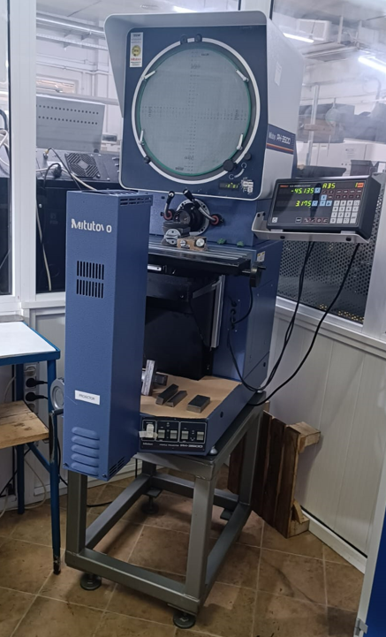
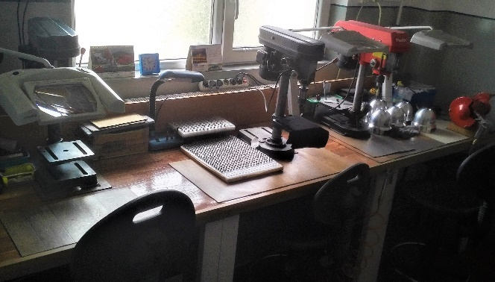
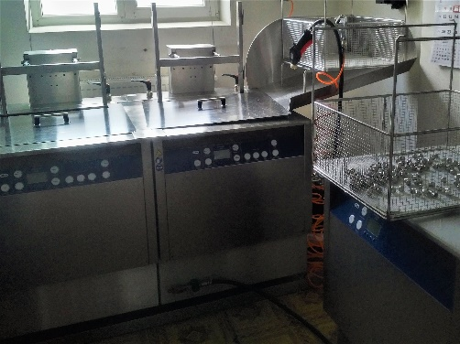
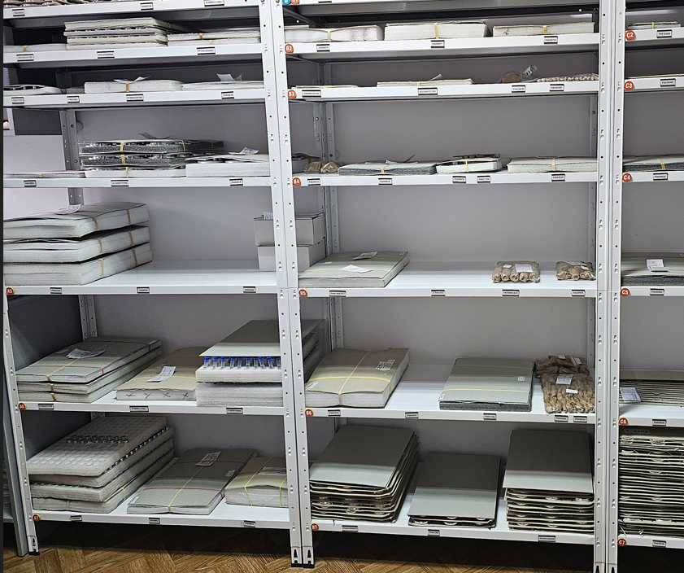
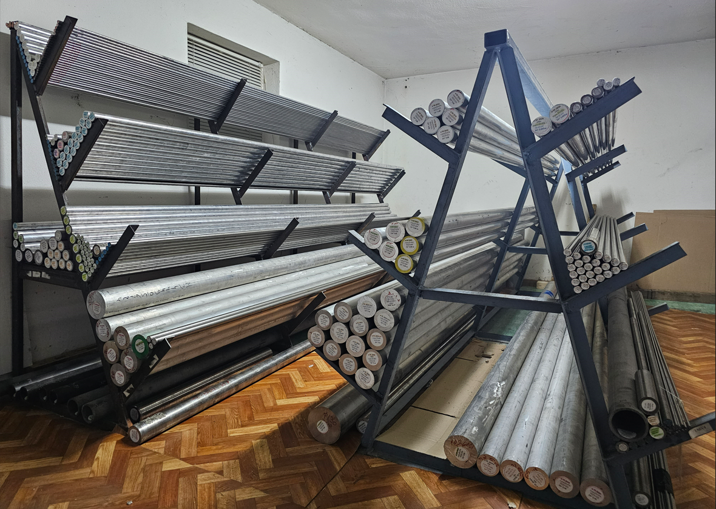
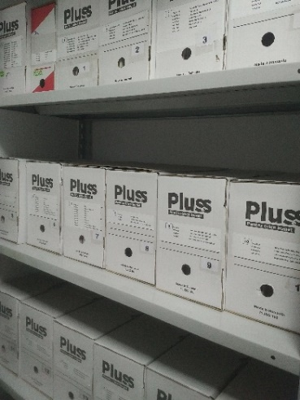
Production department /administrative
Adjustment compartment
Flow control compartment
Ultrasonic cleaning
Finished Products Warehouse
Archive manufacturing files
Material warehouse

Slide 9
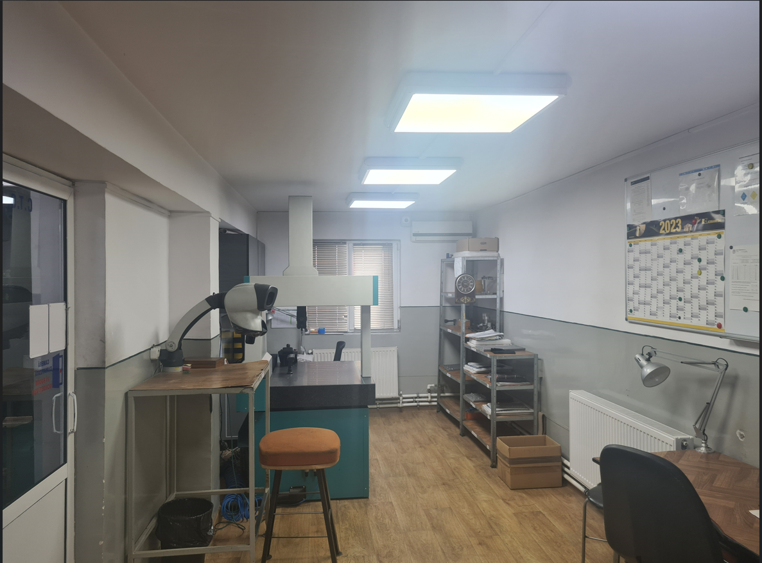
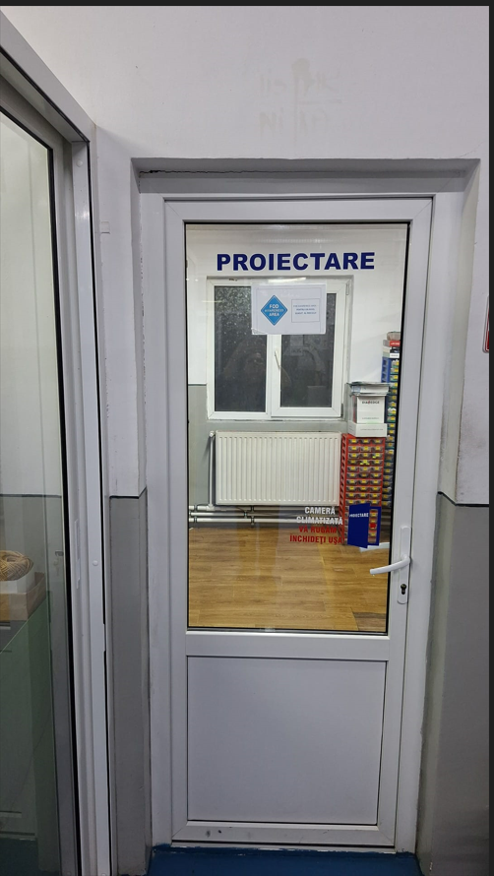
Production / administrative department
Final control compartment
Technology design compartment

Slide 10




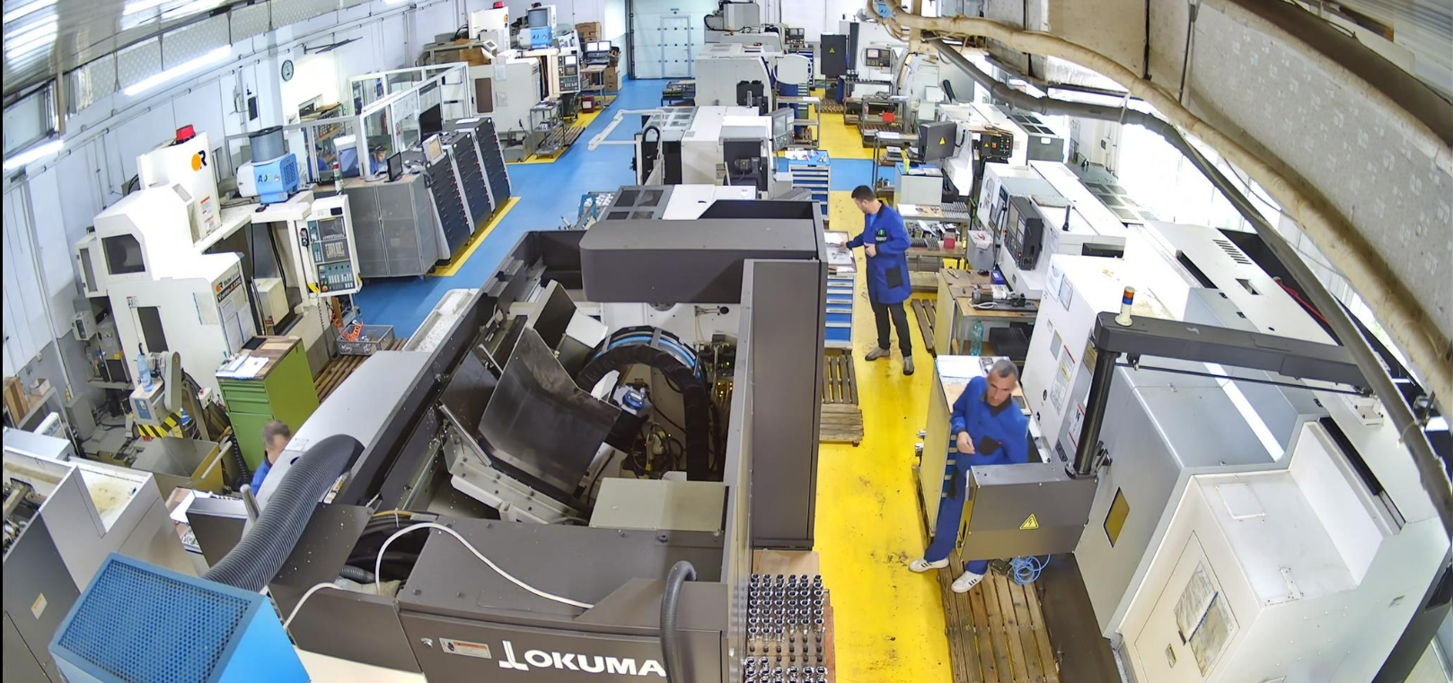
Technological equipment
Machining Operations
• CNC turning
• CNC milling
• Multi-axis machining
• Drilling and tapping
• Precision finishing operations
• CNC turning centers
• CNC machining centers – 3 axis
• CNC machining centers – 4 axis
• CNC machining centers – 5 axis
11/21 Calea Romanului 43, Bacău, 600384, România, Tel.0234 570 633, E-mail: office@psapet.ro www.psapet.ro

Slide 11

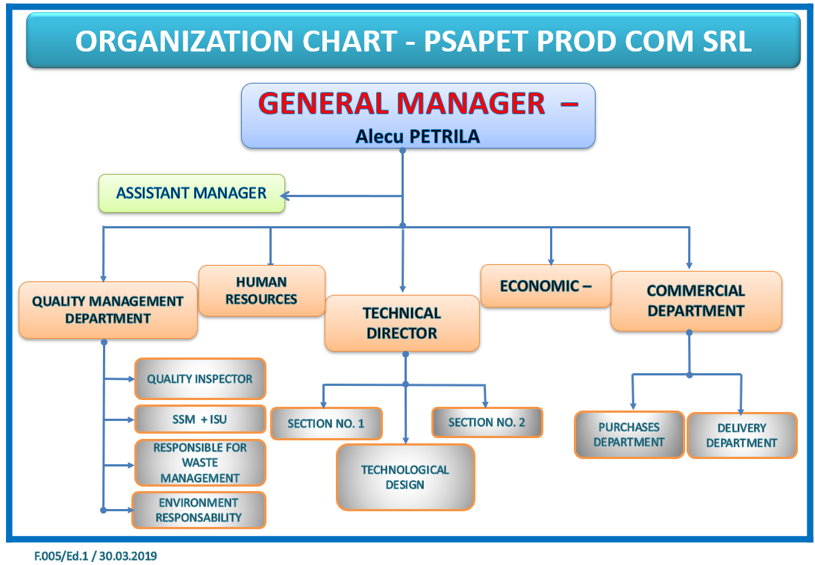
7/21 Calea Romanului 43, Bacău, 600384, România, Tel.0234 570 633, E-mail: office@psapet.ro www.psapet.ro

Slide 12

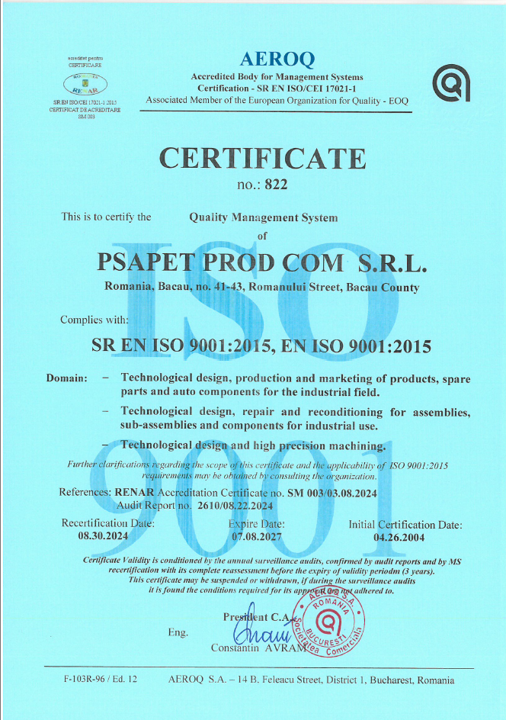
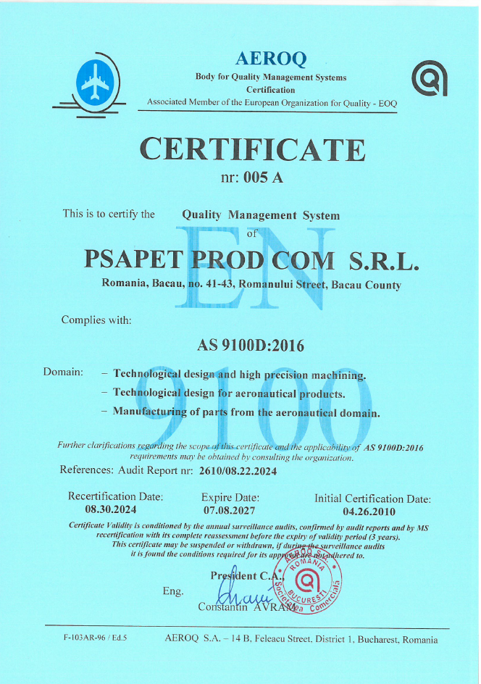
Certification Quality management system
In 2004 the certification according to ISO 9000 was obtained and in 2010 the certification according to AS 9100 was obtained.
12/21 Calea Romanului 43, Bacău, 600384, România, Tel.0234 570 633, E-mail: office@psapet.ro www.psapet.ro

Slide 13


Workforce collaborations
The organization PSAPET PROD COM SRL collaborates with the Vasile Alecsandri University of Bacau in order to offer the chance for students from the first year of study to develop and apply the notions they acquire at courses through practice.
Most of the employees have completed university studies at the Vasile Alecsandri University in Bacau and at the same time some employees who are in the first or second year of study.
Students can opt for one of the following variants of internship selection and practice activities for various activities within the organization:
- CNC operators;
Quality inspectors;
Preparation of manufacturing technologies;
CNC programmers;
Quality management;
And other activities that are necessary for good
the technological flow.

Slide 14
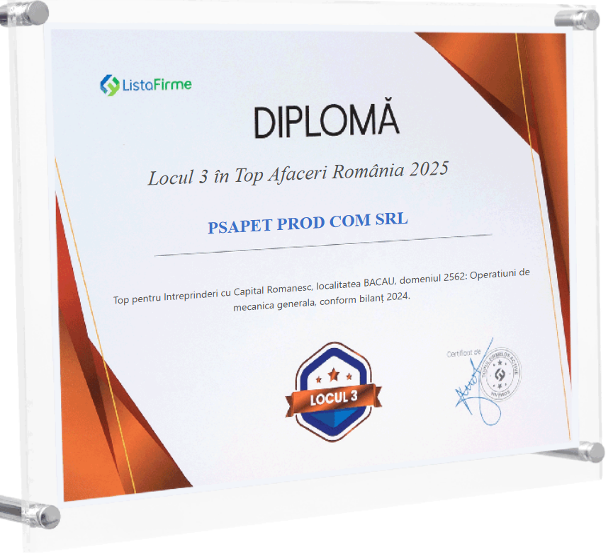
Recognitions
The place of the company occupied in the industry at the level of country
20/21 Calea Romanului 43, Bacău, 600384, România, Tel.0234 570 633, E-mail: office@psapet.ro www.psapet.ro

Slide 15
Thank you for your attention!
21/21 Calea Romanului 43, Bacău, 600384, România, Tel.0234 570 633, E-mail: office@psapet.ro www.psapet.ro

